Slide 1
DEVELOPING MACHINE LEARNING ALGORITHMS TO PRICE AMERICAN-STYLE STOCK OPTIONS
ENPH 455
Presented by: Nathan Pacey

Slide 2


THE PROBLEM
Predicting stock option values is very difficult due to volatility and market efficiency.
American Style options particularly challenging due to the ability to realize value at any point before expiration.

Slide 3
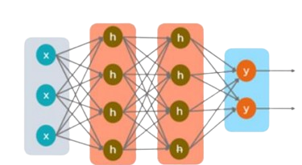
Problem Definition
To overcome these challenges and predict option values accurately, this project leverages Machine Learning (ML).
Specifically utilizing a many-to-many RNN and comparing different architectures.
Training on data from 56 large cap equities.
Starting with hyper parameter values that have been used on stock and other time series data and iterating.
[1]

Slide 4
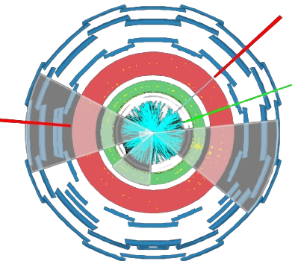

Why is this Important?
Accurate option pricing aids traders in identifying mispriced options and arbitrage opportunities.
The project's success can contribute to better-informed trading decisions.
The optimization of ML algorithms on unpredictable data offers valuable insights.
[2]

Slide 5
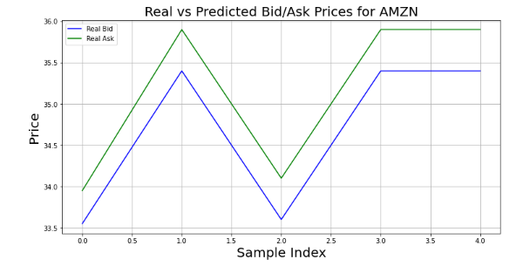
Specific Goals
Develop a machine learning model to capture correlations among option parameters, historical performance, and value to traders.
Precisely predict ask and bid spreads.
Minimize prediction errors.
Contribute to broader time-series data analysis and ML optimization research through parameter iteration.
Spread

Slide 6
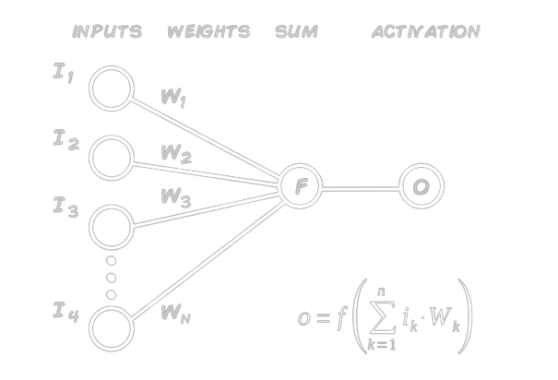
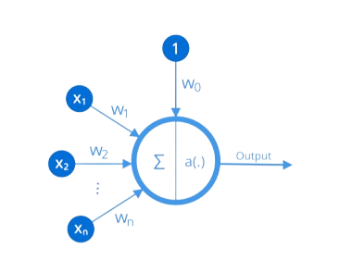
How Does a Machine Learn?
The core component of machine learning models: the artificial neuron, similar to biological neurons.
Neurons form network layers and conduct mathematical operations.
Neurons process inputs with associated weights, involving linear transformations and nonlinear activation functions [4].
[5]
[4]

Slide 7
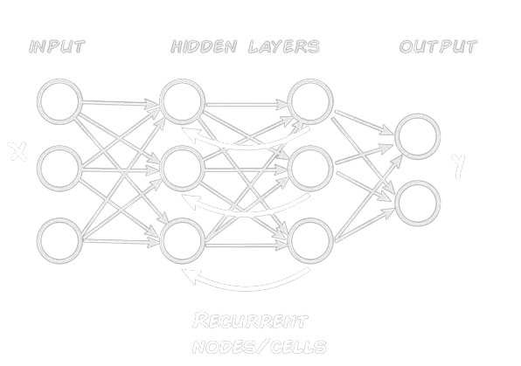
Recurrent Neural Networks (RNNs)
Specialized for sequential data with memory and temporal dynamics.
Three layers: input, hidden, output.
Input data processed through hidden layers with activations.
Independent hidden layers with unique weights and biases.
RNNs preserve temporal relationships by merging past and current inputs, capturing hidden dependencies [5, 6].
[5]
Notes:
Include activation functions which normalize the data and prevent vanishing and diverging values

Slide 8
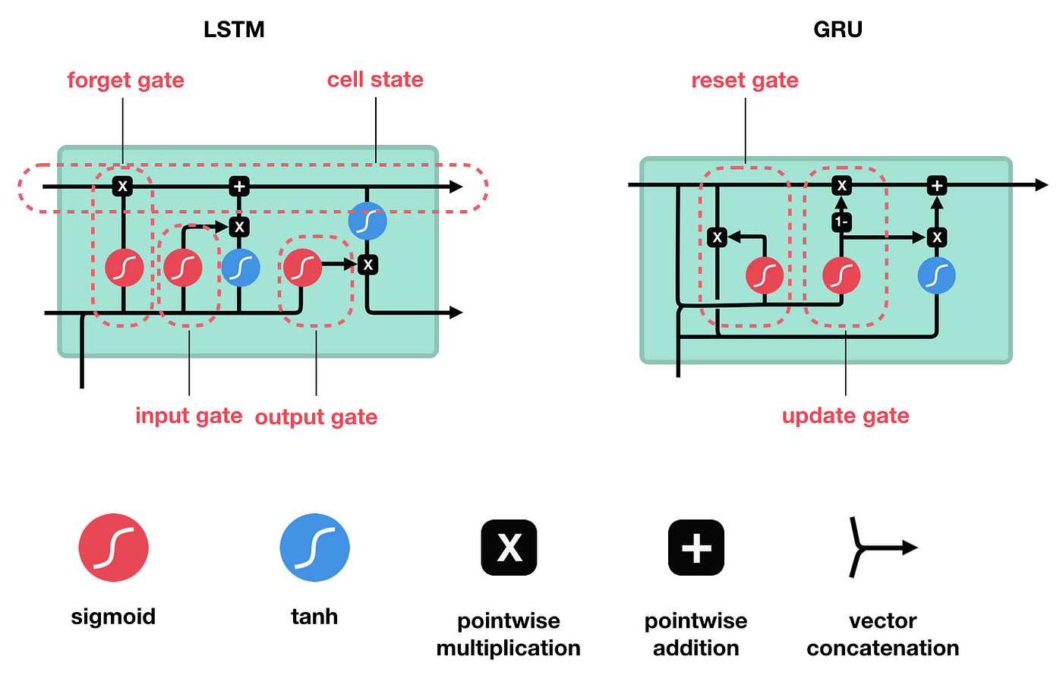
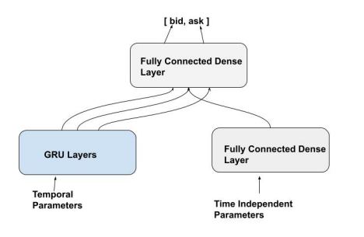
Focus on two RNN Designs
Long Short-Term Memory (LSTM) Networks
Specialized RNNs for learning long-term dependencies.
Composed of memory cell, input gate, forget gate, and output gate.
[7]
Hybrid GRU and Fully Connected Model
Separates non-temporal parameters (date, time, contract name, etc.) from time-dependent ones.
Feeds the GRU output into a fully connected layer.
Effective at segregating daily market movements by distinguishing temporal parameters.
Notes:
However LSTM’s have been shown to still have problems with gradient descent and capturing features from far in the past.
This is due to the structure which includes only a forget gate and a input gate, whereas in a GRU there is an update gate that takes the input along with past information and determines the important features of the entire dataset as well as a reset gate to forget unimportant data.

Slide 9
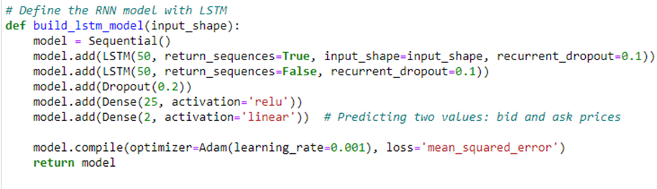
Initial LSTM Model Architecture
Historical options data for 56 companies from February 2022 to December 2022
Follows Graduate Thesis model for stock options [6].
2 LSTM layers (50 units each), dropout layer.
2 fully connected layers (25 units, relu & 2 units, linear).
Compiled with Adam optimizer (LR: 0.001, MSE loss

Slide 10
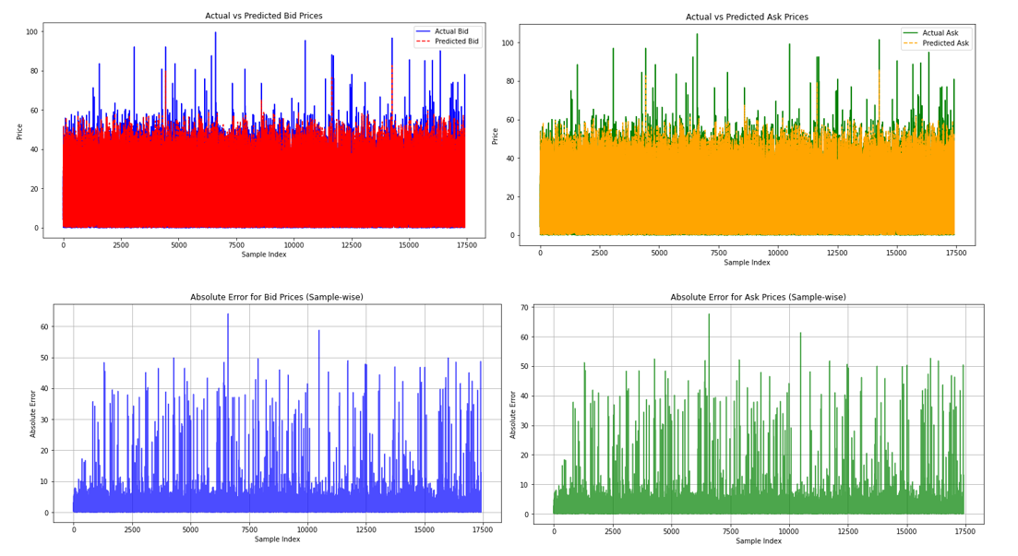
Initial LSTM Model Results

Slide 11
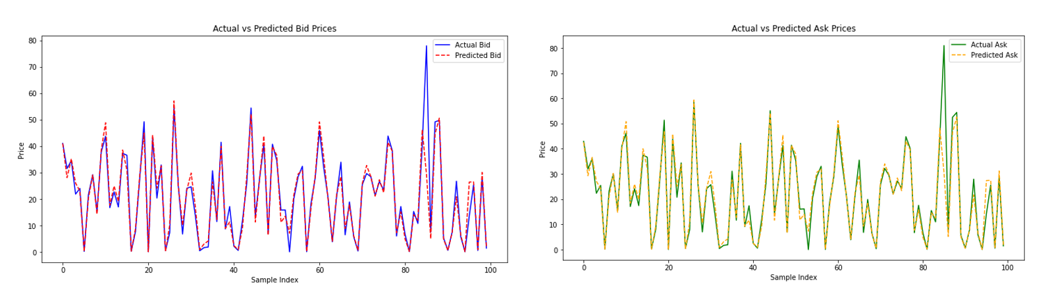
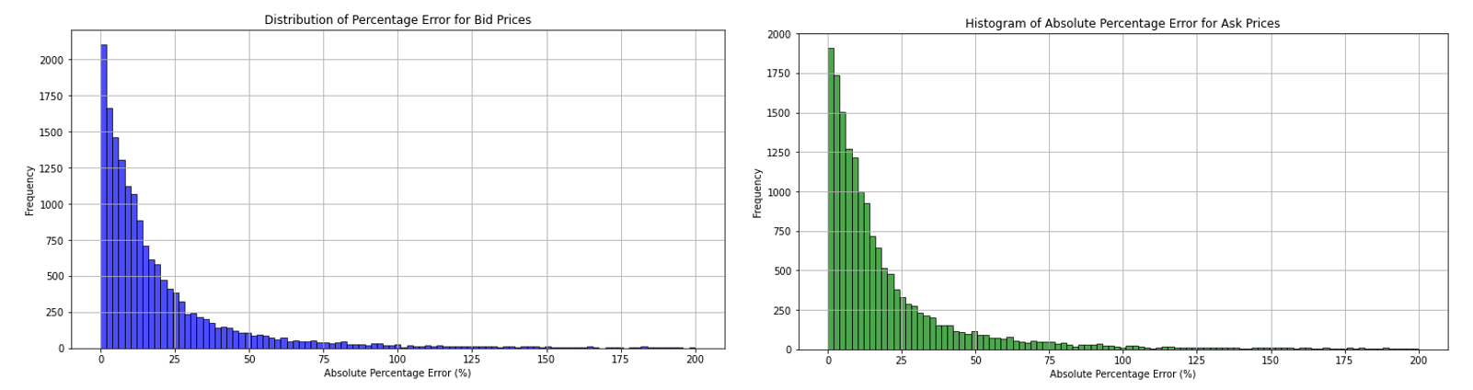

Slide 12
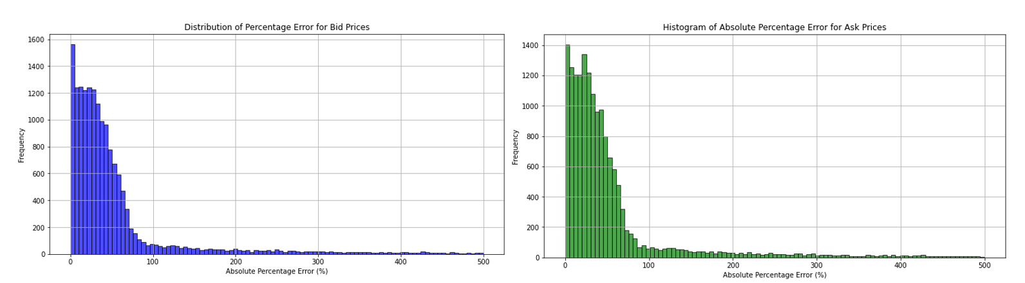
Adjusted Data Split

Slide 13
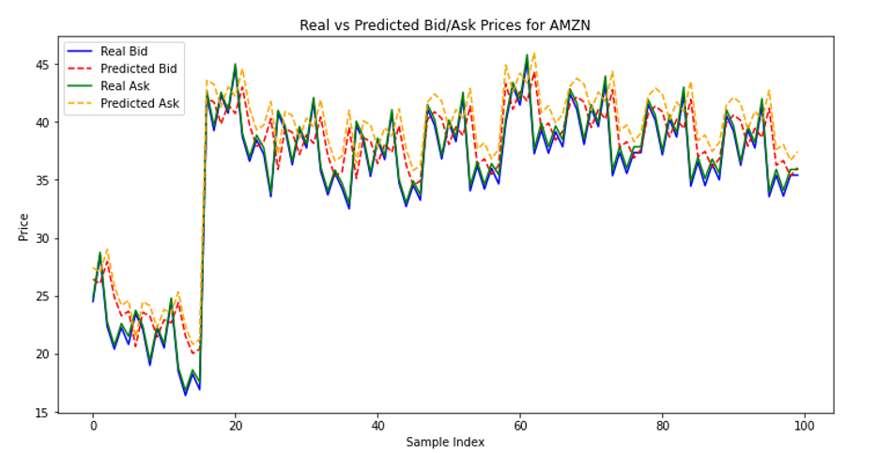
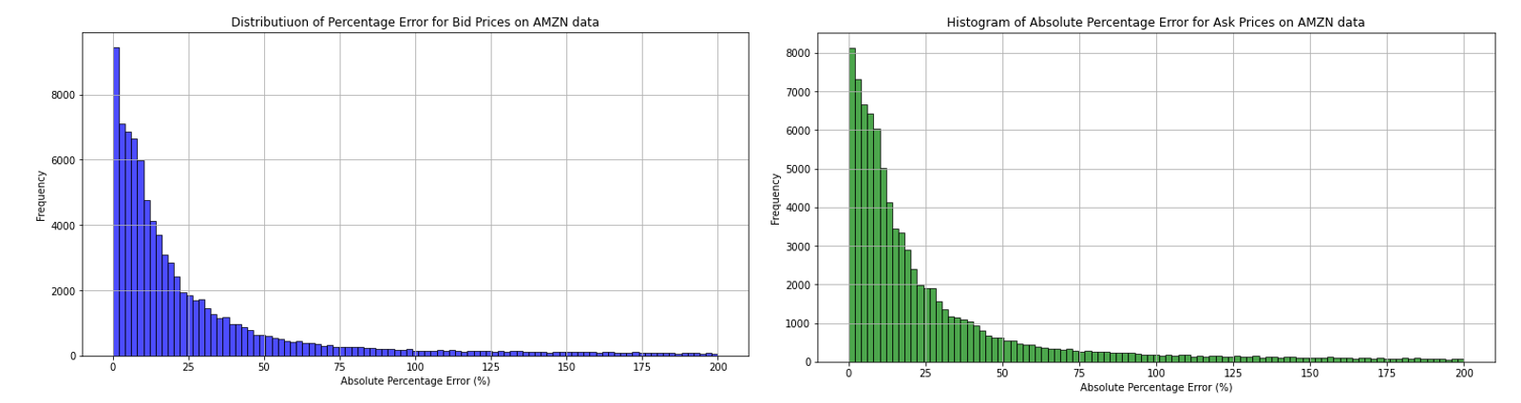
How does the model perform on entirely new data?
Surprisingly well?

Slide 14
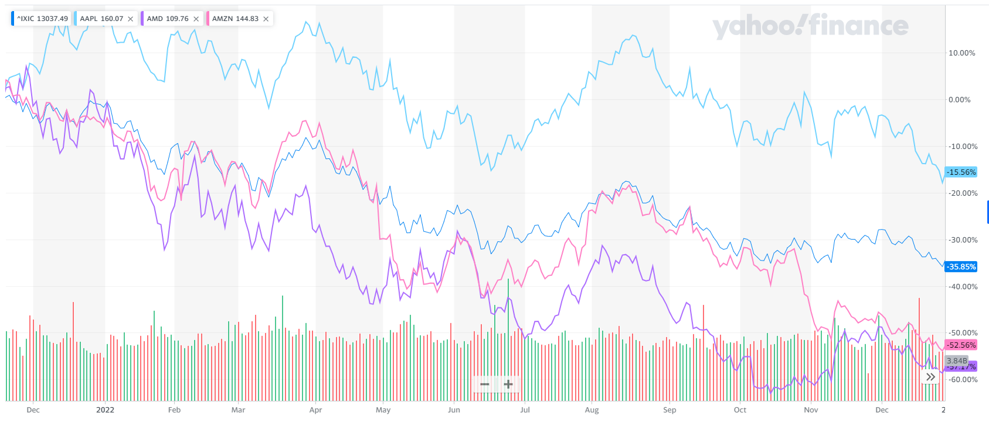
Why did the Amazon Predictions have low error?
The mix of option types and parameters in the last 20% differs significantly from the first 80%, posing pricing challenges. More likely the model recognized market movements on a particular day.
[8]

Slide 15
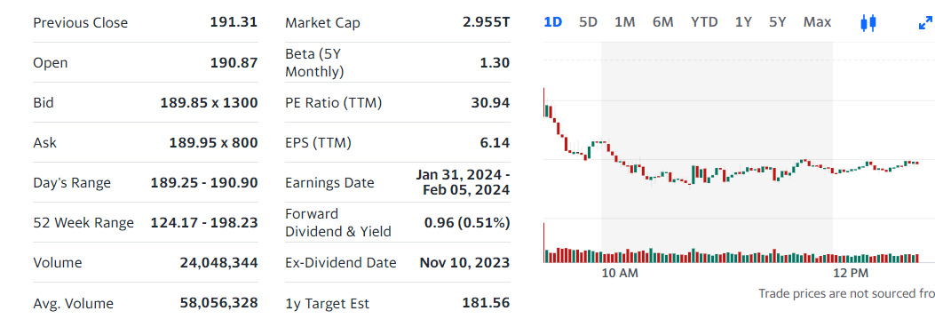
Future Progress: Model Optimization and Comparisons
Get testing data from the newest 20% contracts for each ticker to better simulate real-life scenarios.
Research normalization techniques
Continue to Fine tune LSTM
Develop the Hybrid Model to separate time dependencies
This could reduce error with a realistic dataset.
Compare Hybrid model results to LSTM and continue to iterate focusing on error reduction
[8]

Slide 16
Questions?

Slide 17
References
[1] D. Kalita, "A Brief Overview of Recurrent Neural Networks (RNN)," Analytics Vidhya, 3 August 2023. [Online]. Available: https://www.analyticsvidhya.com/blog/2022/03/a-brief-overview-of-recurrent-neural-networks-rnn/. [Accessed 13 October 2023].
[2] P. Haasch, "The 'stonks' meme is surging in the internet economy amid the GameStop stock saga. Here's how it rose to notoriety.," January 2021. [Online]. Available: https://www.insider.com/stonks-meme-origin-stocks-dogecoin-gamestop-hold-line-memes-game-2021-1.
[3] ATLAS Collaberation, "ATLAS searches for new phenomena using unsupervised machine learning for anomaly detection," CERN, 24 August 2023. [Online]. Available: https://atlas.cern/Updates/Briefing/Anomaly-Detection.
[4] S. Cristina, "Calculus in Action: Neural Networks," Machine Learning Mastery, 16 March 2022. [Online]. Available: https://machinelearningmastery.com/calculus-in-action-neural-networks/. [Accessed 22 November 2023].
[5] K. Leon, "A Guide to Artificial Neural Network Visualizations," 28 November 2022. [Online]. Available: https://k3no.medium.com/a-guide-to-artificial-neural-network-visualizations-d5ea7a1cc9c4.
[6] I. Jahan, "Stock Price Prediction Using Recurrent Neural Networks," North Dakota State University, Fargo, 2018.
[7] M. Phi, "Illustrated Guide to LSTM’s and GRU’s: A step by step explanation," Medium, 24 September 2018. [Online]. Available: https://towardsdatascience.com/illustrated-guide-to-lstms-and-gru-s-a-step-by-step-explanation-44e9eb85bf21.
[8] Yahoo! Finance, "Interactive Chart," Yahoo, [Online]. Available: https://finance.yahoo.com/chart.

